Slide 1
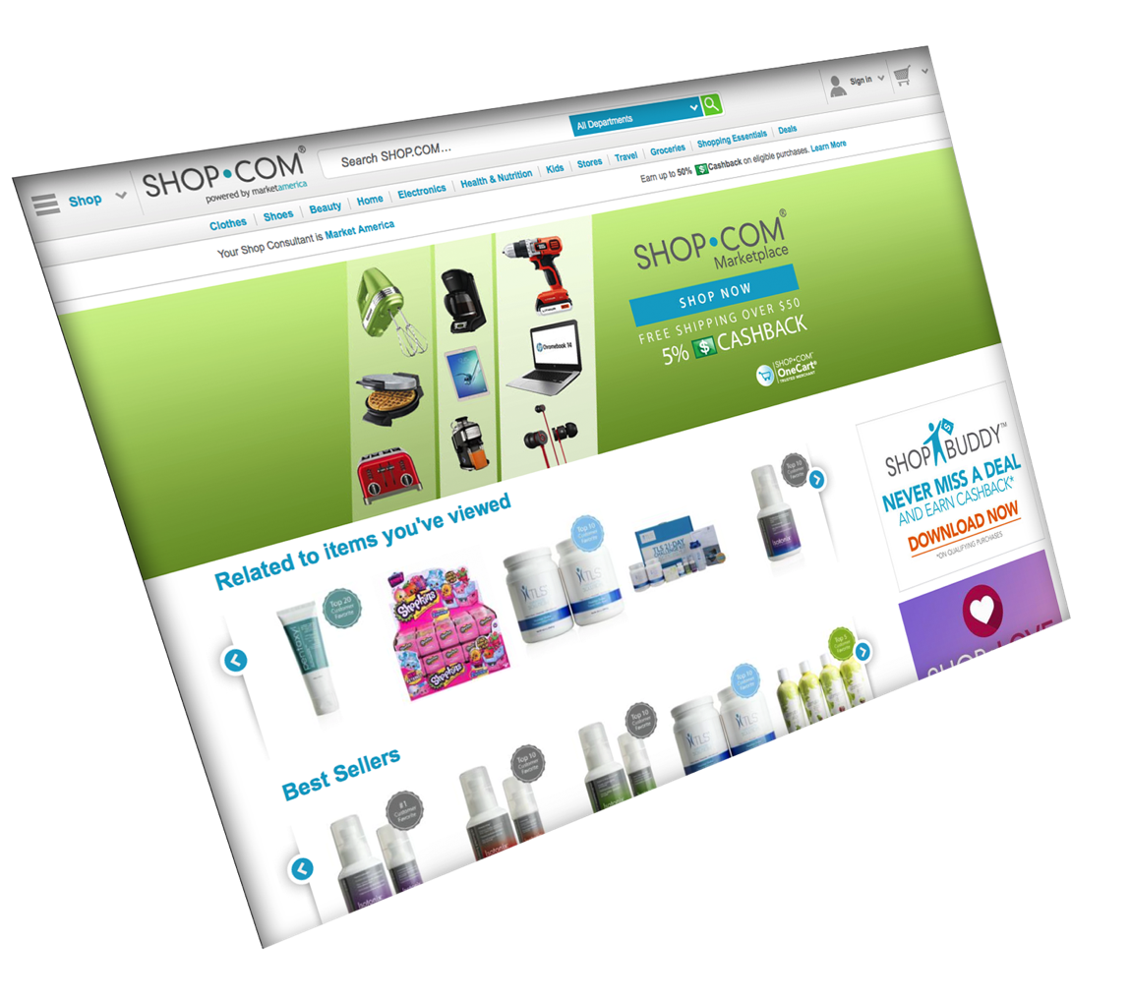
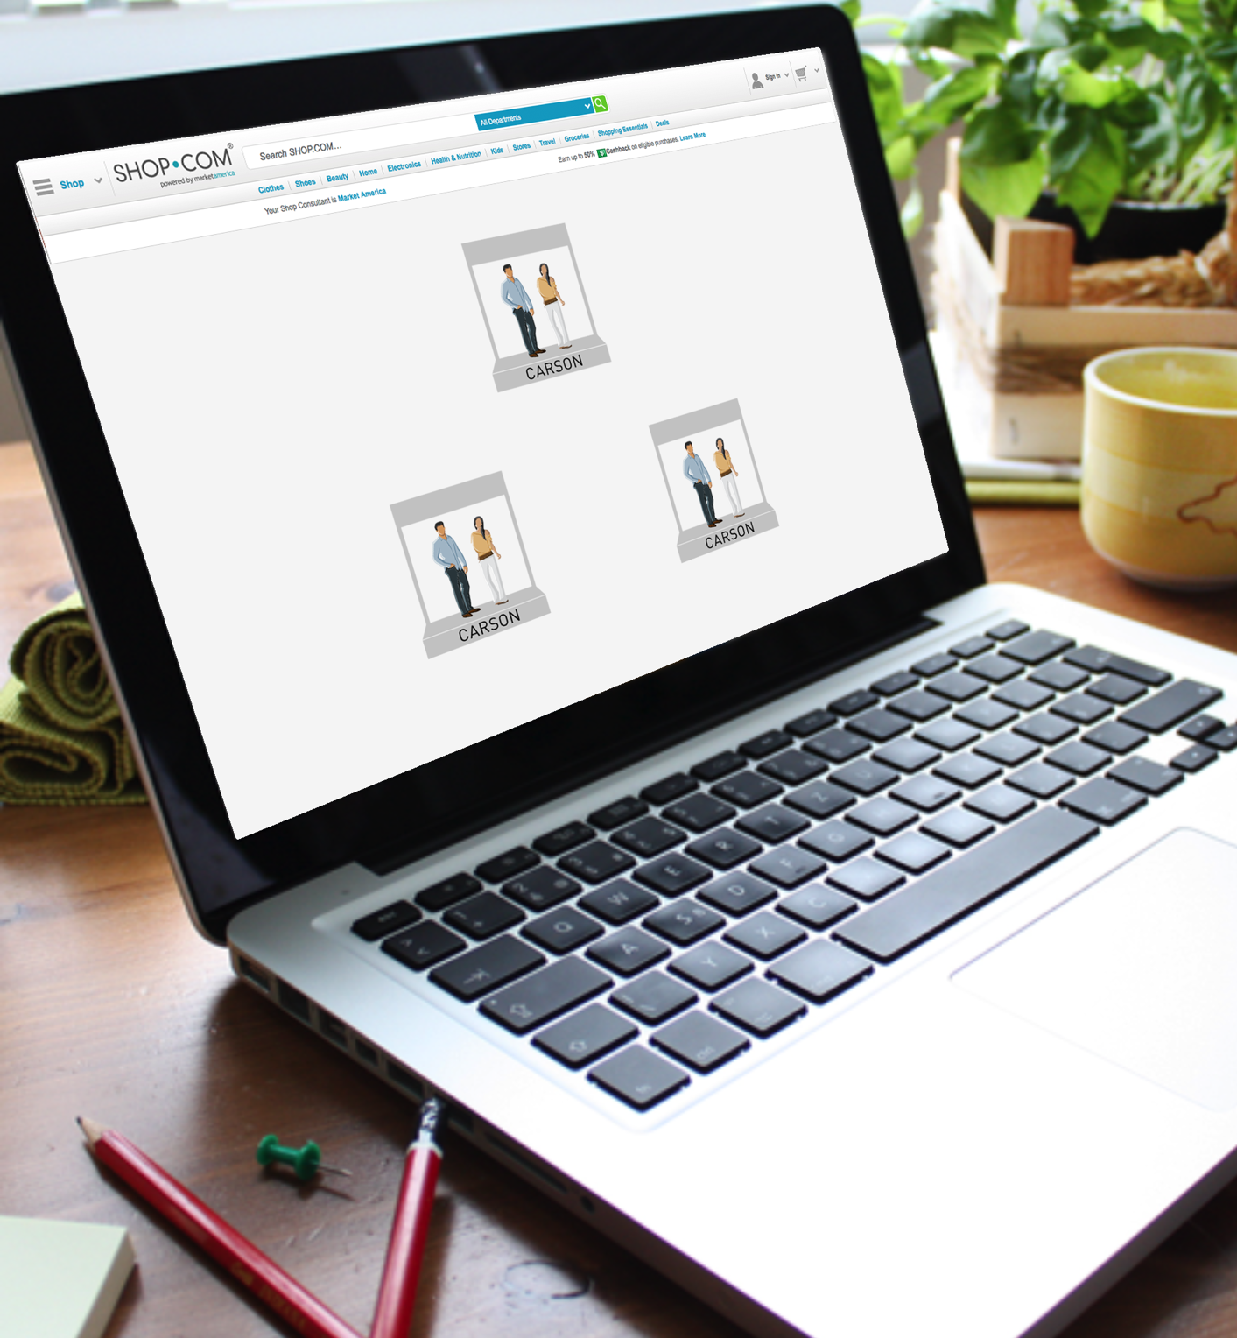

[
]
SHOPPING ANNUITY RECRUITING
ARLENE LOWY

Slide 2
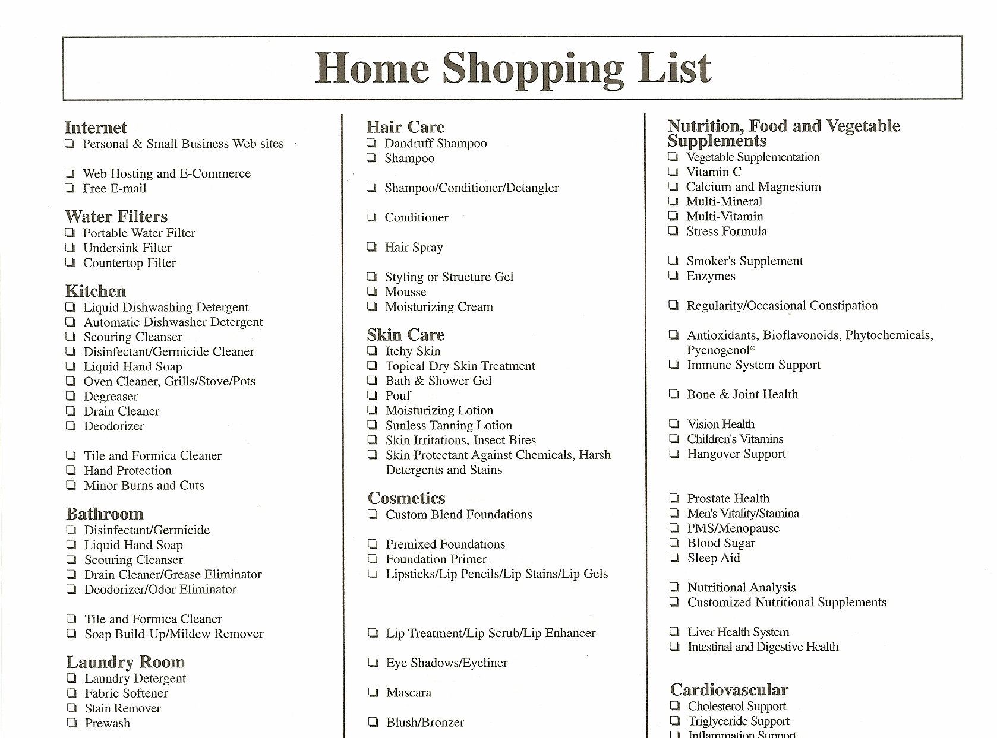

Slide 3

WHERE DO YOU SHOP?

Slide 4
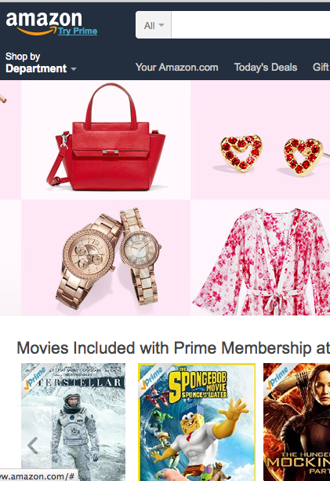
REALLY?!
WHEN DID THEY START PAYING YOU CASHBACK?
FREE SHIPPING? OR $99?
THEY MARKET PRODUCTS THAT PAY FOR THAT PLACEMENT

Slide 5

Income and Household
Statistics
Average family earns:
$56,352
Average family spends:
$51,100
BUREAU OF LABOR STATISTICS, TABLE 1400 CONSUMER EXPENDITURES 2013, BASED ON CONSUMER UNIT WWW.BLS.GOV/CEX

Slide 6

$18,750 or more
of that spending could be redirected to SHOP.COM
Create a Shopping Annuity by converting your spending into earning

Slide 7


Average income
after taxes:
$56,352
Total average
annual expenditures:
$51,100
Personal Care Product & Service
Miscellaneous
Entertainment
Reading
$18,750 or more
could be redirected to
SHOP.COM
Healthcare
Food
Transportation
Housing
Apparel & Service
*Bureau of Labor Statistics, Table 1400 Consumer Expenditures 2013,
based on consumer unit www.bls.gov/cex

Slide 8


Market America can track and capture all your purchases from our stores, brands and merchants.
When you or anyone you lead to directly or indirectly, makes a purchase you get credit in the form of a social currency called
BV and IBV.
That currency accumulates and when it reaches certain thresholds, you earn a residual income through the MPCP.
Personal Care Product & Service
Personal Care Product & Service
Miscellaneous
Personal Care Product & Service
Miscellaneous
Miscellaneous
Reading
Entertainment
Reading
Entertainment
Entertainment
Reading
Healthcare
Food
Healthcare
Food
does it for you
Healthcare
Food
Housing
Transportation
Housing
Transportation
Apparel & Service
Apparel & Service
Transportation
Housing
Apparel & Service

Slide 9
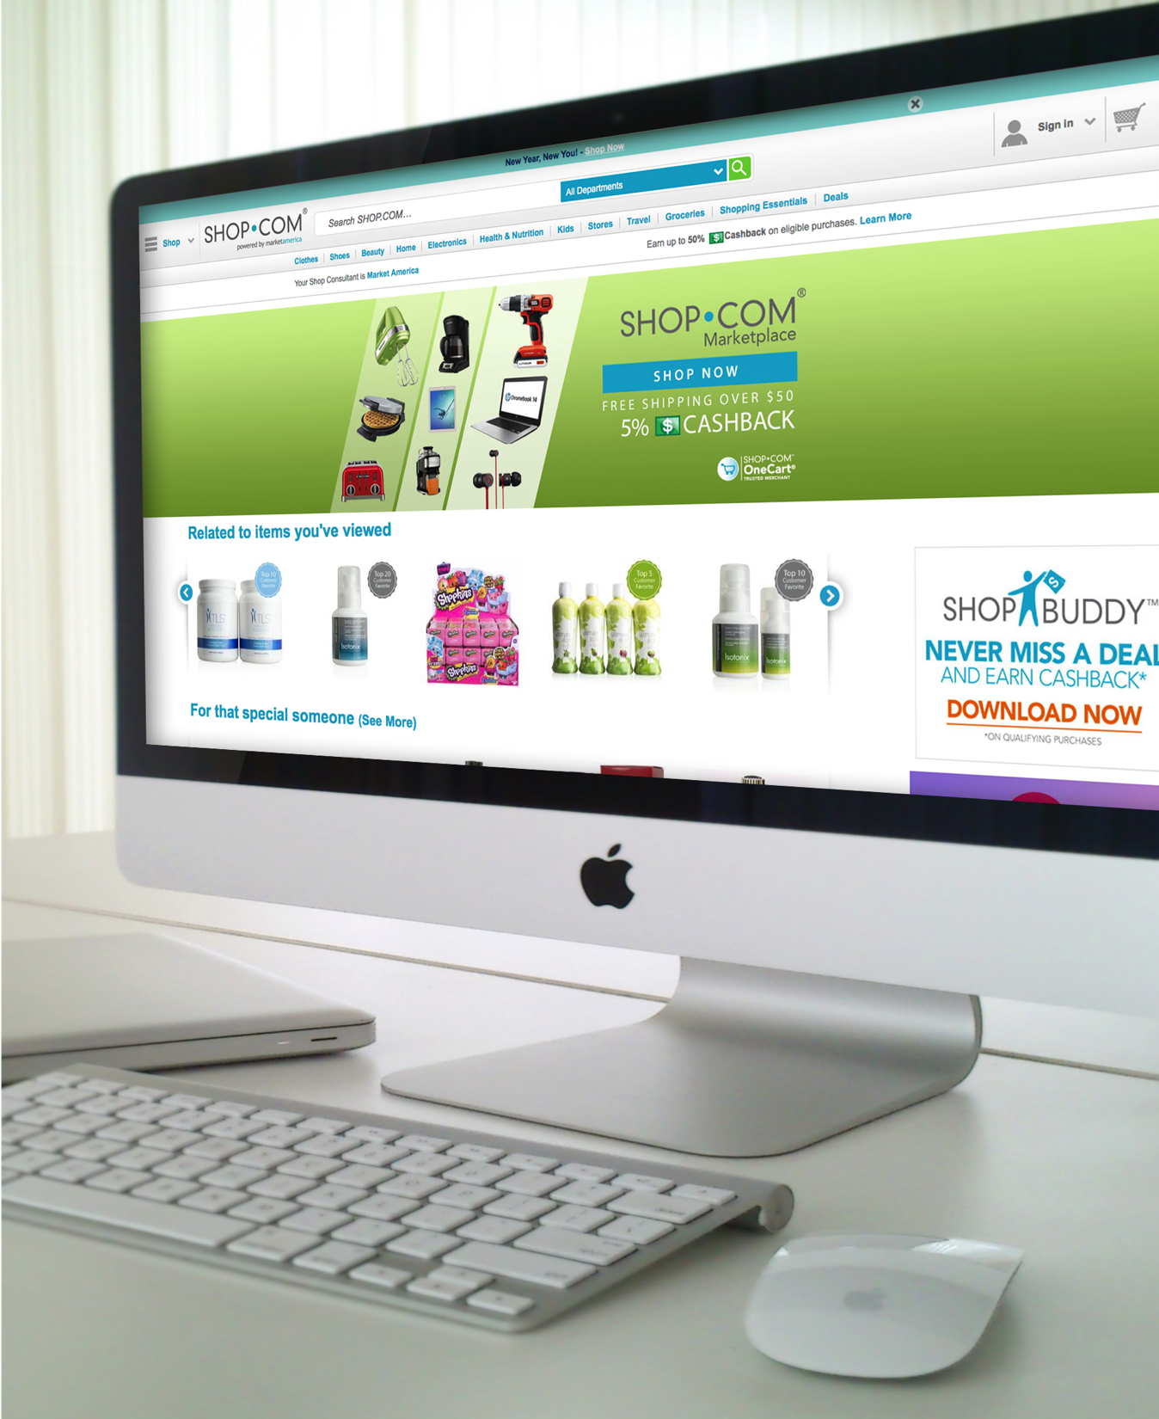
SHOW THEM SHOP.COM
FREE TO BE A PREFERRED CUSTOMER
CASHBACK
REFER A FRIEND
EGIFTS
COMPARATIVE SHOPPING
STORES
PRICE ALERTS
SHOP DIRECT
SHOP BUDDY
PRODUCT BROKERAGE

Slide 10



NOW WHAT
Big Al Sheet
Sign them up as a Preferred Customer
Transferring your Spending
Book a follow up

Slide 11


